Slide 1
Does Efficiency = Wins
By Greg Wandro

Slide 2
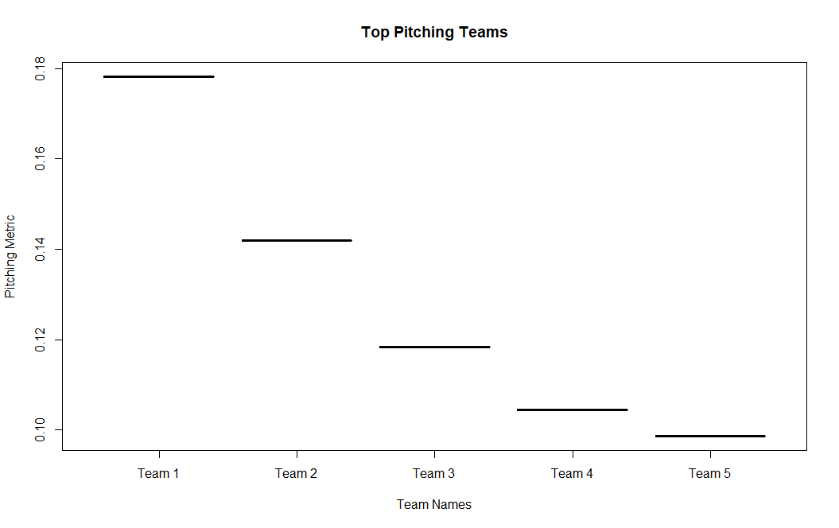
Most Efficient Pitching Teams
Metric: Strikeouts / Pitches Thrown
Team 1 = 4c2ad3df-a7fd-458d-a412-6e31574a0b7b
107 Season wins
Team 2 = c5fefa38-a256-43fe-8147-008c0f8c2f15
150 Season wins
Team 3 = a7768b3c-3700-41a8-b97d-4670e044d036
86 Season wins
Team 4 = 8256c5cd-476c-4af3-8c26-059b0fd8ddcf
114 Season wins
Team 5 = 9ccdfc26-a7e7-4bcb-8879-3e77d391d58f
134 Season wins

Slide 3
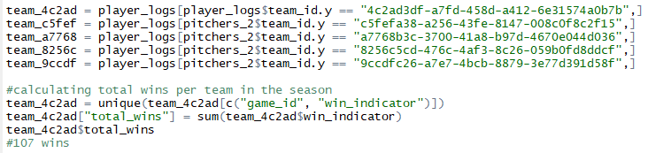
R Code
Created Dataframe with only starting pitchers
Start the game strong and carry the momentum
Remove NAs and 0s
Converted Wins to 1
Aggregated Pitching metric by player for the season
Aggregated season wins for each team the top 5 players are on

Slide 4

Inference
Efficient pitching does not always lead to wins
The most efficient pitching team had the 2nd lowest wins
What could have caused this?
While the pitcher was efficient, batters may have made contact on the first pitch
The team may not have perform well when it came to batting

Slide 5
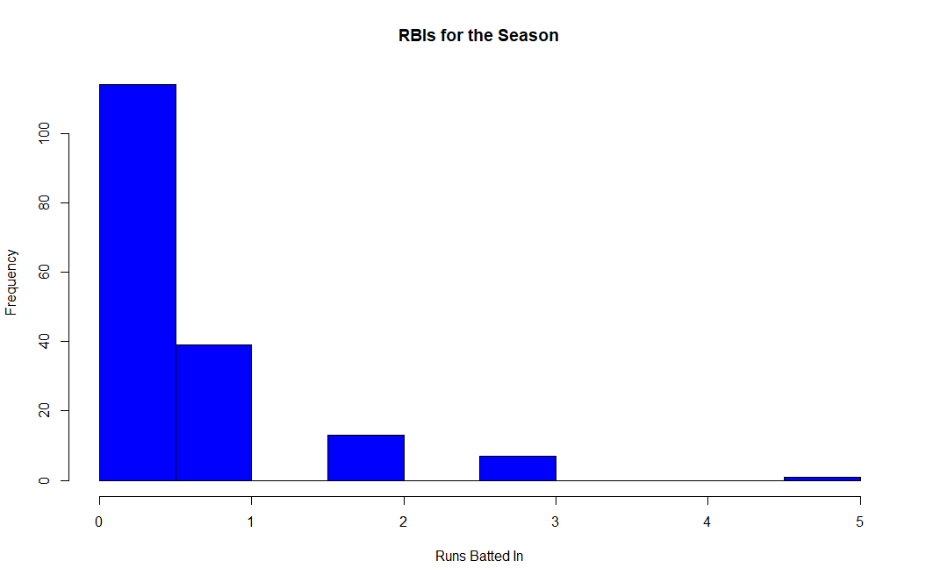
Top RBI Player in the League
Top Player by player_id:
2c755f68-04a7-464f-9f7a-302b40241736 (Jonathan Lucroy)
RBI_Metric: .1625 (runs batted in / at bats)
Of the 560 at bats, this player drove in 91 runs
His team finished with 50 wins for the season

Slide 6
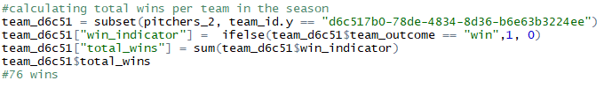
R Code
Removed NAs and 0s
Aggregated the RBI metric by player for the season
Sorted by unique player to find most efficient batter
Then ran a subset function to create Dataframe for top player’s team
Totaled wins to see how well the team did for the season

Slide 7

Inference
Efficient batting does not always lead to wins
The team with the most efficient batter in terms of RBIs only won 50 games
Baseball is a team sport, and the contributions of the entire team seem to matter more than the individual player

